Slide 1
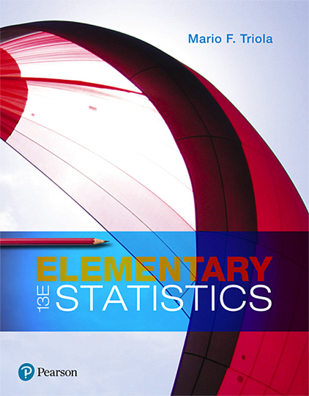
Elementary Statistics
Thirteenth Edition
Chapter 2
Exploring Data with Tables and Graphs
Copyright © 2018, 2014, 2012 Pearson Education, Inc. All Rights Reserved

Slide 2
Exploring Data with Tables and Graphs
2-1 Frequency Distributions for Organizing and Summarizing Data
2-2 Histograms
2-3 Graphs that Enlighten and Graphs that Deceive
2-4 Scatterplots, Correlation, and Regression

Slide 3
Key Concept
When working with large data sets, a frequency distribution (or frequency table) is often helpful in organizing and summarizing data. A frequency distribution helps us to understand the nature of the distribution of a data set.

Slide 4
Frequency Distribution
Frequency Distribution (or Frequency Table)
Shows how data are partitioned among several categories (or classes) by listing the categories along with the number (frequency) of data values in each of them.

Slide 5
Definitions (1 of 2)
Lower class limits
The smallest numbers that can belong to each of the different classes
Upper class limits
The largest numbers that can belong to each of the different classes
Class boundaries
The numbers used to separate the classes, but without the gaps created by class limits

Slide 6
Definitions (2 of 2)
Class midpoints
The values in the middle of the classes Each class midpoint can be found by adding the lower class limit to the upper class limit and dividing the sum by 2.
Class width
The difference between two consecutive lower class limits in a frequency distribution

Slide 7
Procedure for Constructing a Frequency Distribution (1 of 2)
Select the number of classes, usually between 5 and 20.
Calculate the class width.
Round this result to get a convenient number. (It’s usually best to round up.)

Slide 8
Procedure for Constructing a Frequency Distribution (2 of 2)
Choose the value for the first lower class limit by using either the minimum value or a convenient value below the minimum.
Using the first lower class limit and class width, list the other lower class limits.
List the lower class limits in a vertical column and then determine and enter the upper class limits.
Take each individual data value and put a tally mark in the appropriate class. Add the tally marks to get the frequency.

Slide 9
Example: McDonald’s Lunch Service Times (1 of 5)
Using the McDonald’s lunch service times in the first table, follow the procedure shown on the next slide to construct the frequency distribution shown in the second table. Use five classes.
Drive-through Service Times (seconds) for McDonald’s Lunches
107 | 139 | 197 | 209 | 281 | 254 | 163 | 150 | 127 | 308 | 206 | 187 | 169 | 83 | 127 | 133 | 140
143 | 130 | 144 | 91 | 113 | 153 | 255 | 252 | 200 | 117 | 167 | 148 | 184 | 123 | 153 | 155 | 154
100 | 117 | 101 | 138 | 186 | 196 | 146 | 90 | 144 | 119 | 135 | 151 | 197 | 171 | 190 | 169 | Blank
Time (Seconds) | Frequency
75-124 | 11
125-174 | 24
175-224 | 10
225-274 | 3
275-324 | 2
McDonald’s Lunch Drive-Through Service Times

Slide 10
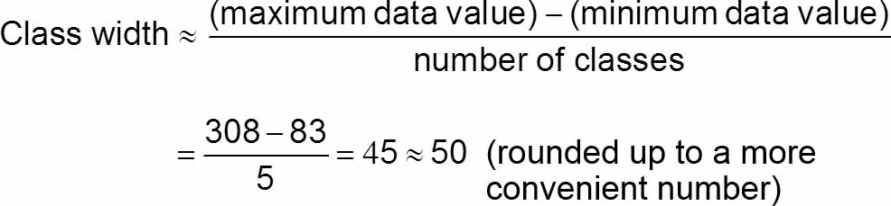
Example: McDonald’s Lunch Service Times (2 of 5)
Step 1: Select 5 as the number of desired classes.
Step 2: Calculate the class width as shown below. Note that we round 45 up to 50,which is a more convenient number.

Slide 11
Example: McDonald’s Lunch Service Times (3 of 5)
Step 3: The minimum data value is 83, which is not a very convenient starting point, so go to a value below 83 and select the more convenient value of 75 as the first lower class limit.
Step 4: Add the class width of 50 to the starting value of 75 to get the second lower class limit of 125. Continue to add the class width of 50 until we have five lower class limits. The lower class limits are therefore 75, 125, 175, 225, and 275.

Slide 12
Example: McDonald’s Lunch Service Times (4 of 5)
Step 5: List the lower class limits vertically, as shown below. From this list, we identify the corresponding upper class limits as 124, 174, 224, 274, and 324.
75-
125-
175-
225-
275-

Slide 13
Example: McDonald’s Lunch Service Times (5 of 5)
Step 6: Enter a tally mark for each data value in the appropriate class. Then add the tally marks to find the frequencies shown in the table.
Time (Seconds) | Frequency
75-124 | 11
125-174 | 24
175-224 | 10
225-274 | 3
275-324 | 2

Slide 14
Relative Frequency Distribution (1 of 2)
Relative Frequency Distribution or Percentage Frequency Distribution
Each class frequency is replaced by a relative frequency (or proportion) or a percentage.

Slide 15
Relative Frequency Distribution (2 of 2)
Relative Frequency Distribution or Percentage Frequency Distribution
Each class frequency is replaced by a relative frequency (or proportion) or a percentage.
The sum of the percentages in a relative frequency distribution must be very close to 100% (with a little wiggle room for rounding errors).

Slide 16
Cumulative Frequency Distribution
Cumulative Frequency Distribution
The frequency for each class is the sum of the frequencies for that class and all previous classes.
Cumulative Frequency Distribution of McDonald’s Lunch Service Times
Time (Seconds) | Cumulative Frequency
Less than 125 | 11
Less than 175 | 35
Less than 225 | 45
Less than 275 | 48
Less than 325 | 50

Slide 17
Critical Thinking: Using Frequency Distributions to Understand Data
In statistics we are often interested in determining whether the data have a normal distribution.
The frequencies start low, then increase to one or two high frequencies, and then decrease to a low frequency.
The distribution is approximately symmetric. Frequencies preceding the maximum frequency should be roughly a mirror image of those that follow the maximum frequency.

Slide 18
Gaps
The presence of gaps can show that the data are from two or more different populations.
However, the converse is not true, because data from different populations do not necessarily result in gaps.

Slide 19
Example: Exploring Data: What Does a Gap Tell Us? (1 of 2)
The table shown is a frequency distribution of the weights (grams) of randomly selected pennies.
Weight (grams) of Penny | Frequency
2.40-2.49 | 18
2.50-2.59 | 19
2.60-2.69 | 0
2.70-2.79 | 0
2.80-2.89 | 0
2.90-2.99 | 2
3.00-3.09 | 25
3.10-3.19 | 8

Slide 20
Example: Exploring Data: What Does a Gap Tell Us? (2 of 2)
Examination of the frequencies reveals a large gap between the lightest pennies and the heaviest pennies.
This suggests that we have two different populations:
Pennies made before 1983 are 95% copper and 5% zinc.
Pennies made after 1983 are 2.5% copper and 97.5% zinc.

Slide 21
Comparisons
Combining two or more relative frequency distributions in one table makes comparisons of data much easier.

Slide 22
Example: Comparing McDonald’s and Dunkin’ Donuts (1 of 2)
The table shows the relative frequency distributions for the drive-through lunch service times (seconds) for McDonald’s and Dunkin’ Donuts.
Time (seconds) | McDonald’s | Dunkin’ Donuts
25-74 | Blank | 22%
75-124 | 22% | 44%
125-174 | 48% | 28%
175-224 | 20% | 6%
225-274 | 6% | Blank
275-324 | 4% | Blank

Slide 23
Example: Comparing McDonald’s and Dunkin’ Donuts (2 of 2)
Time (seconds) | McDonald’s | Dunkin’ Donuts
25-74 | Blank | 22%
75-124 | 22% | 44%
125-174 | 48% | 28%
175-224 | 20% | 6%
225-274 | 6% | Blank
275-324 | 4% | Blank
Because of the dramatic differences in their menus, we might expect the service times to be very different.
By comparing the relative frequencies, we see that there are major differences. The Dunkin’ Donuts service times appear to be lower than those at McDonald’s.

